Slide 1
Assembly Language: Arithmetic and logic instructions
CSE 315
Microprocessors, Microcontrollers, and Embedded Systems

Slide 2
AND, OR AND XOR
Syntax
AND destination, source
OR destination, source
XOR destination, source
The restrictions of destination and source are the same as ADD or SUB instructions

Slide 3
AND, OR AND XOR
Effect on flags
SF, ZF, PF reflect the result
AF is undefined
CF, OF = 0

Slide 4
AND, OR AND XOR
Example
XOR AX, AX
OR AL, 81h
AND AL, 7Fh
Clearing a Register
Set the MSB and LSB while preserving other bits
Clear the Sign Bit

Slide 5
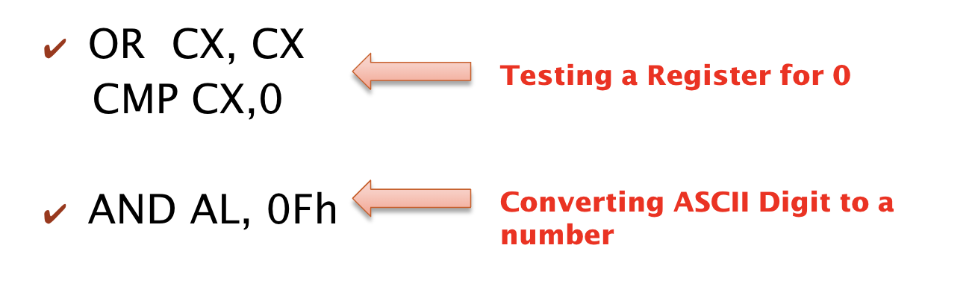

AND, OR AND XOR
Example

Slide 6
NOT Instruction
Works on a single operand
Performs one’s complement operation on the destination
Syntax
NOT destination

Slide 7
TEST Instruction
Performs similarly to the AND instruction
Except doesn’t write the output on the destination.
Only sets or resets the flags
Syntax
TEST destination, source
Usually used for flow control

Slide 8
TEST Instruction
Example
TEST AL,1
Testing a number is even or not

Slide 9
Shift / Rotate Instructions
Has two possible formats:
Opcode destination, 1
Opcode destination, CL
Effect on flags
SF, ZF, PF reflect the result
AF is undefined
CF value changes according to Shift / Rotate Type
OF =1 if result changes sign on last Shift / Rotation

Slide 10
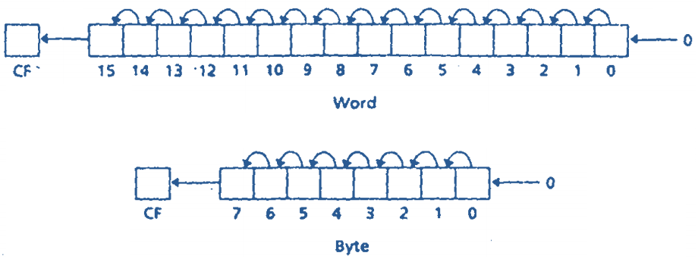
SHL and SAL instructions
Shifts the bits in the destination to the left
The MSB is shifted into CF
A 0 is shifted to LSB
SAL and SHL generate the same machine code
SHL and SAL

Slide 11
SHL and SAL instructions
Example
If DH=8AH, CL=3
What is the result of
SHL DH, CL
If DX=8AH, CX=3
What is the result of
SHL DX, CX
DH=50H
CF=0
OF=0
DX=450H
CF=0
OF=0

Slide 12
Multiplication Using SHL and SAL instructions
A Left shift on a binary number multiplies it by 2
Example
If DH=2H, CL=1
What is the result of
SHL DH, CL
DH=4H
CF=0
OF=0

Slide 13
Overflow Flag Untrustworthy During Multiplication using SHL or SAL
Example
If DH=80H, CL=2
What is the result of
SHL DH, CL
DH=00H
CF=0
OF=0
CF and OF are not reliable for multiple shifts because multiple shifts are just a series of single shifts and CF, OF only reflect the result of the last shift.

Slide 14
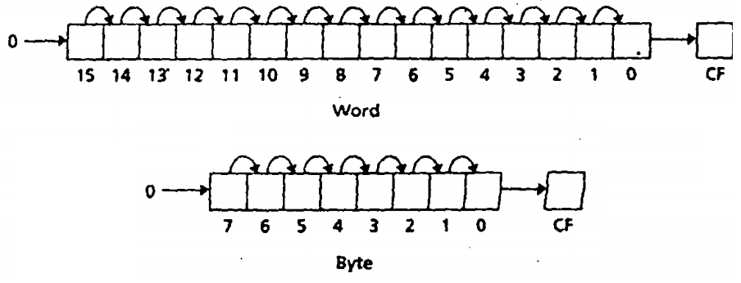
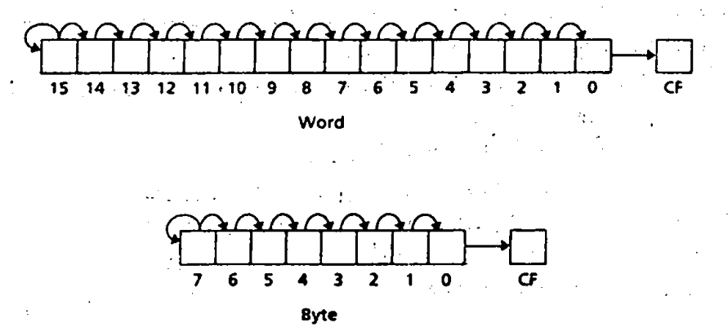
SHR and SAR instructions
Shifts the bits in the destination to the right
The LSB is shifted into CF
In case of SAR MSB retains its original value
SHR
SAR

Slide 15
SHR and SAR instructions
SHR should be used for unsigned interpretation as it does not preserve sign
SAR should be used for signed interpretation as it preserves sign

Slide 16
SHR and SAR instructions
Example
If AL=-15, CL=1
What is the result of
SHR AL, CL
If AL=-15, CL=1
What is the result of
SAR AL, CL
AL=120H
CF=1
OF=1
AL=-8
CF=1
OF=1

Slide 17
Multiplication instructions
imul source
- Signed multiplication
mul source
- Unsigned multiplication
Byte and Word Multiplication (A X B)
If two bytes are multiplied, the result is a 16-bit word
A: source
B: al
product: ax
If two words are multiplied, the result is a 32-bit doubleword
A: source
B: ax
Product (ms 16 bits): dx
Product (ls 16 bits): ax

Slide 18
Multiplication instructions
source can be a register or memory location (not a constant)
Byte form
AX=AL*source
Word form
DX:AX=AX*source
If ax contains 0001h and bx contains FFFFh
mul bx; dx = 0000h ax = FFFFh
imul bx ; dx = FFFFh ax = FFFFh (-1)

Slide 19
Signed Multiplication
C
Assembly
Lable1:
short int x=0x8000;
short int y=0xFFFF;
x=x*y
Label1:
MOV x, 8000H
MOV y, FFFFH
MOV AX, x
MOV BX, y
IMUL BX

Slide 20
Unsigned Multiplication
C
Assembly
Lable1:
unsinged short int x=0x8000;
unsigned short int y=0xFFFF;
x=x*y
Label1:
MOV x, 8000H
MOV y, FFFFH
MOV AX, x
MOV BX, y
MUL BX

Slide 21
Multiplication instructions
Effect on flags
SF, ZF, AF, and PF Undefined
CF/OF
MUL
0: if upper half result 0
1: Otherwise
IMUL
0: if upper half is sign extension of lower half.
1: Otherwise

Slide 22
More Examples
AX=FFFFh,BX=FFFFh
Instruction | Hex Product | DX | AX | CF/OF
MUL BX | FFFE0001 (4294836225) | FFFE (!zero) | 0001 | 1
IMUL BX | 1 | 0000 | 0001 | 0
AX=80h,BX=FFh
Instruction | Hex Product | AH | AL | CF/OF
MUL BX | 7F80 | 7F(!zero) | 80 | 1
IMUL BX | 0080 | 00 (no sign extension) | 80 | 1

Slide 23
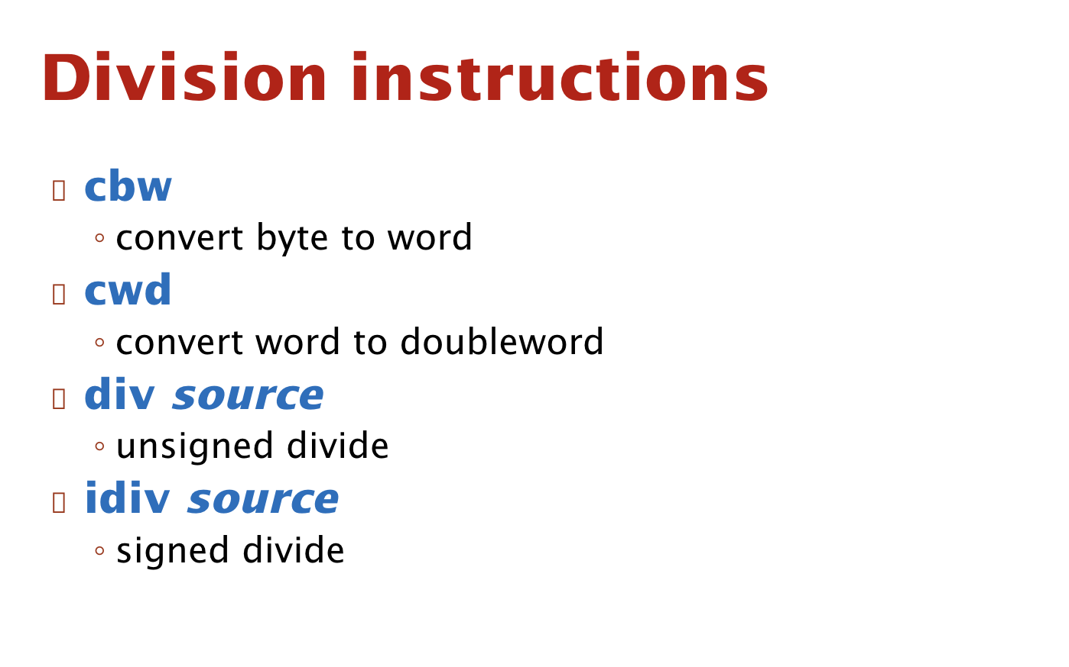

Slide 24
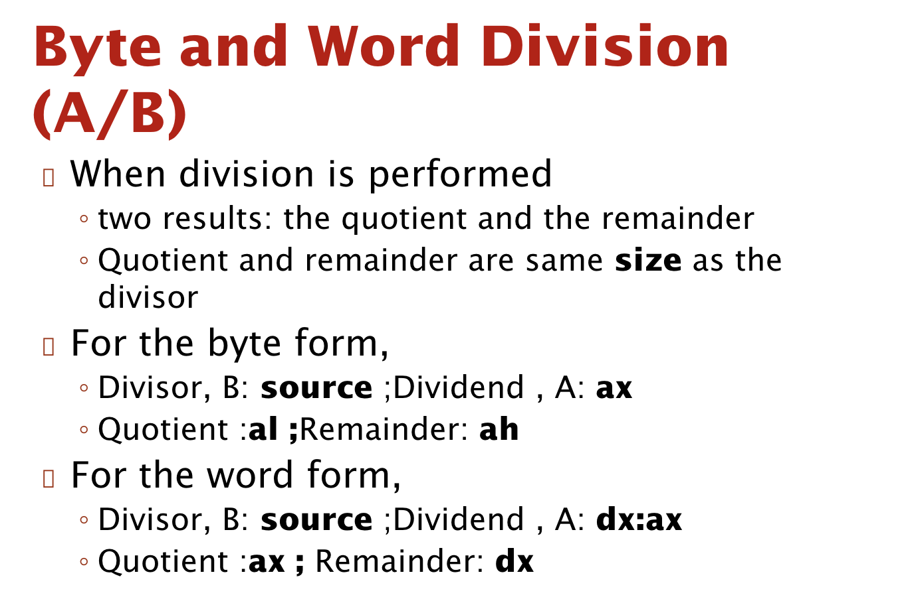

Slide 25
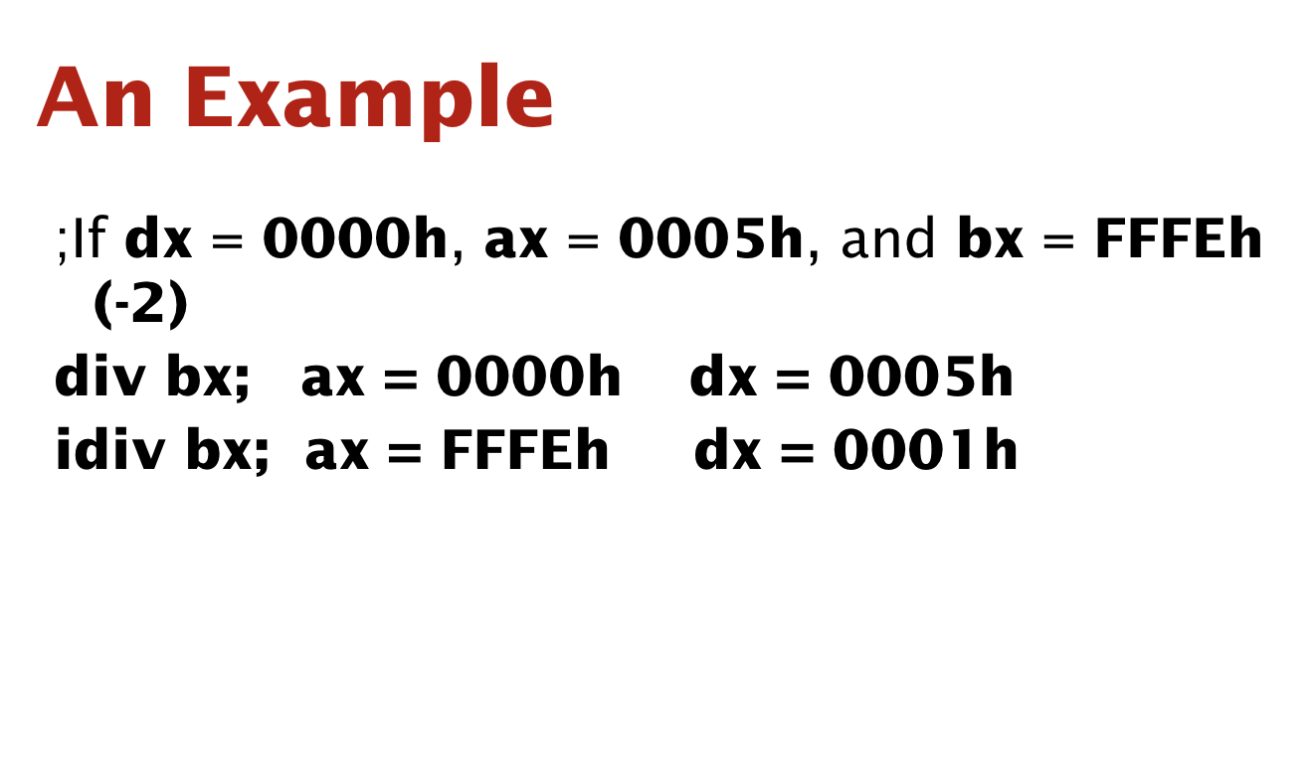

Slide 26
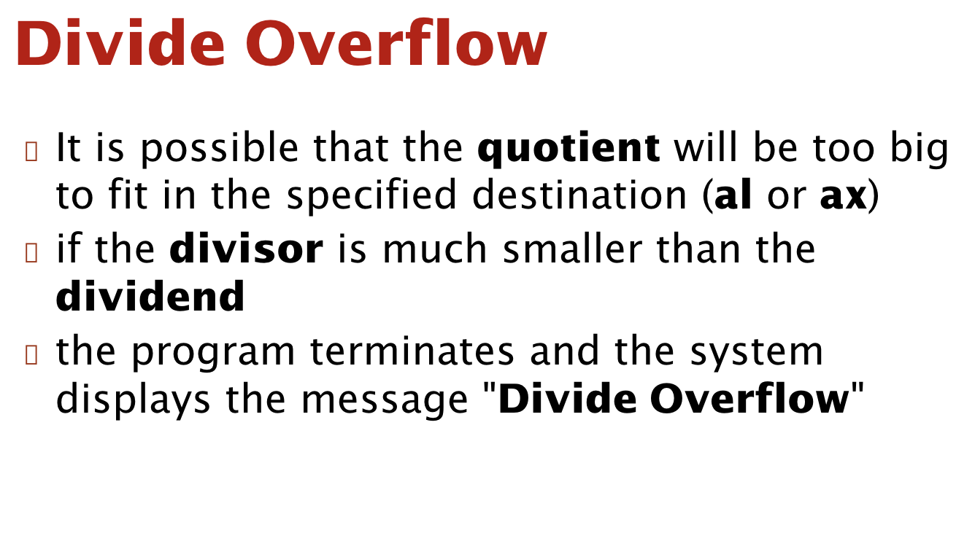

Slide 27
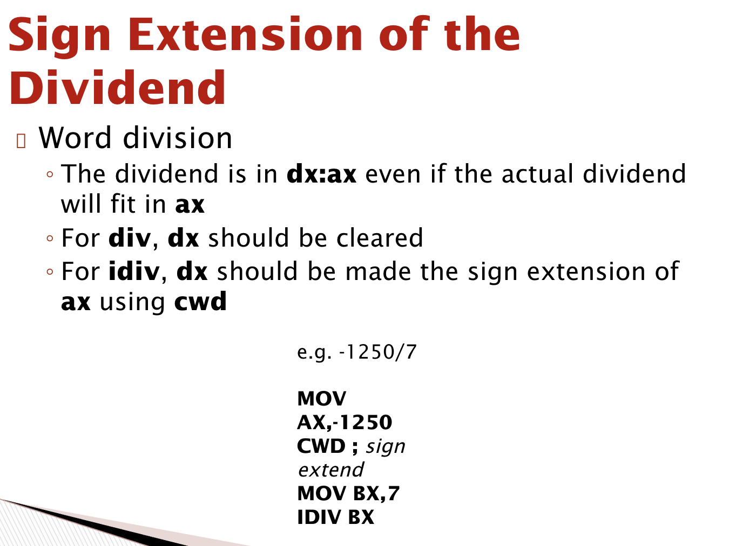

Slide 28
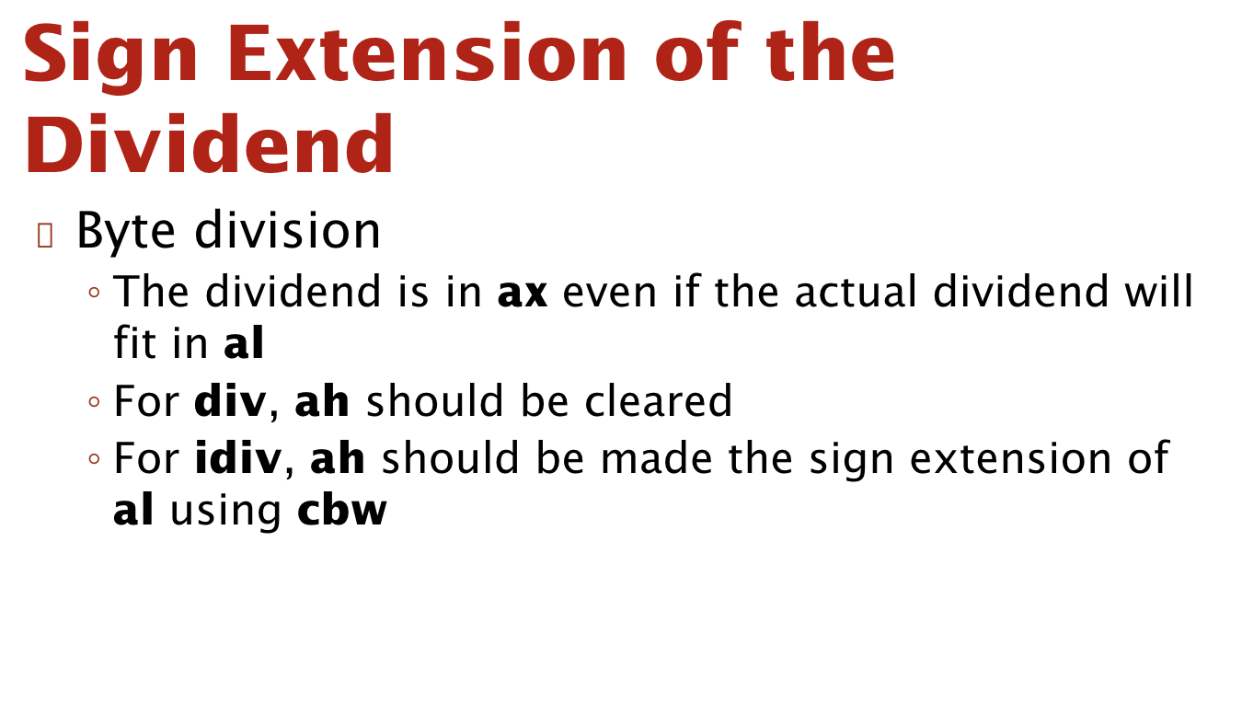

Slide 29
References
Ch 7, 9 Assembly Language Programming – by Yu and Marut

